Slide 1
Experiment 9.
Molar Solubility; Common-ion Effect
Experimental Procedure
Online Class

Slide 2
PART B. Molar Solubility and Solubility Product of Calcium Hydroxide

Slide 3
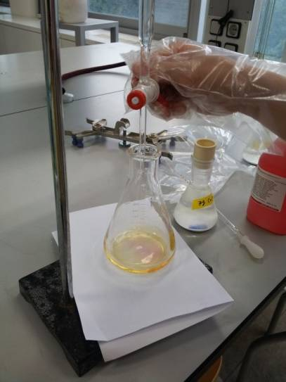
Standardized HCl solution
Ca(OH)₂ solution 25 mL
+ methyl orange indicator (2 drops)
125mL

Slide 4
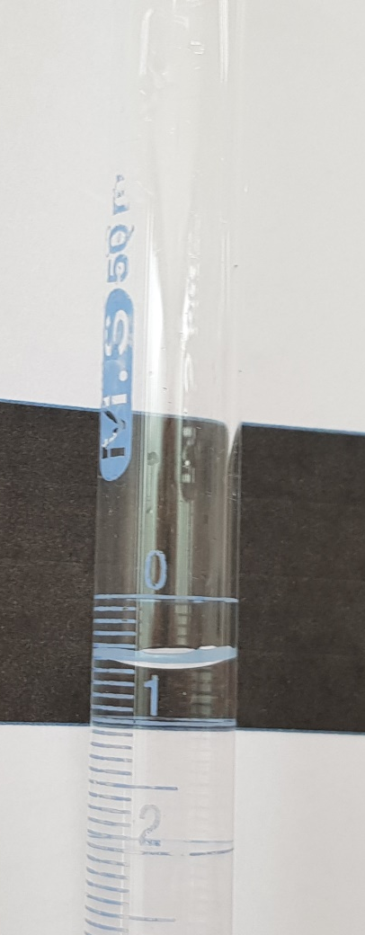
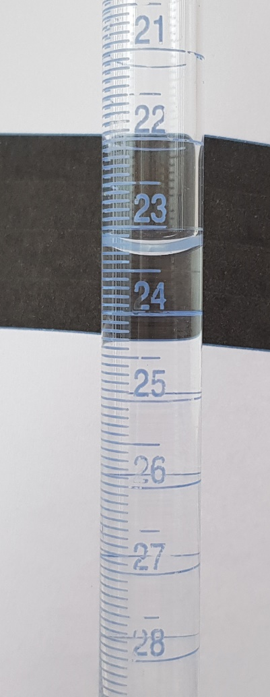
Trial1
Start
Finish

Slide 5
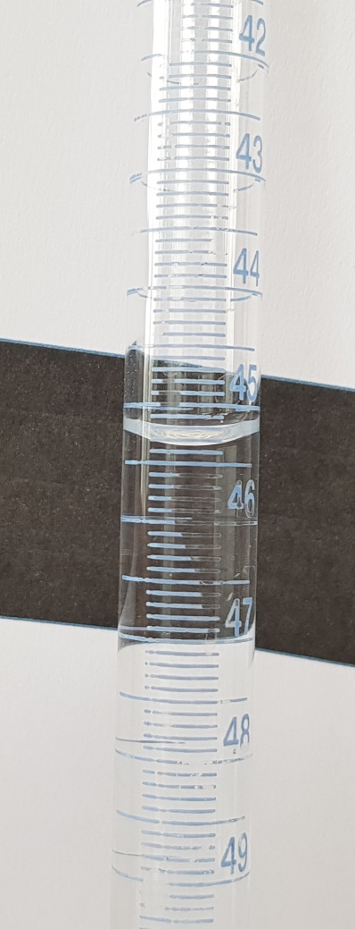
Trial 2
Start
Finish

Slide 6
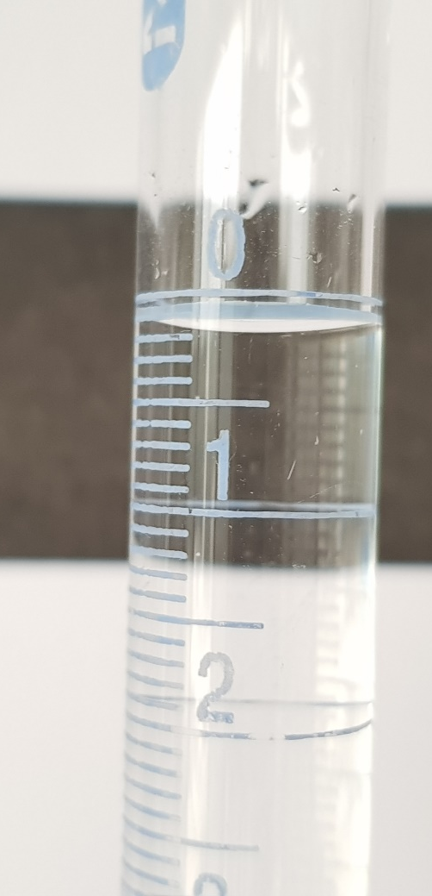
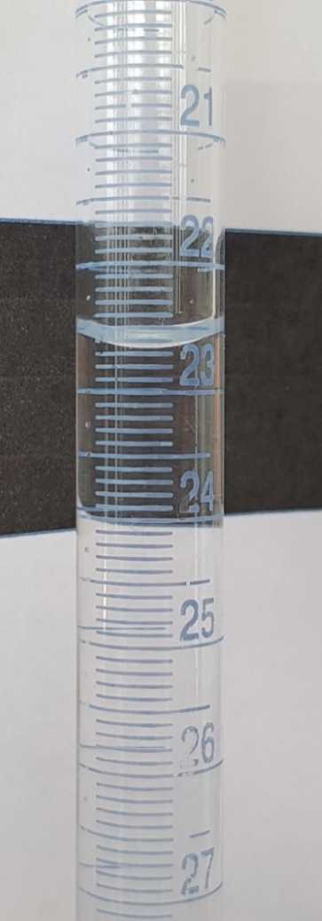
Trial 3
Start
Finish

Slide 7
PART C. Molar Solubility of Calcium Hydroxide in the Presence of a Common Ion

Slide 8
Standardized HCl solution
[Ca(OH)₂ + CaCl₂ Solution] 25 mL
+ methyl orange solution (2 drops)

Slide 9
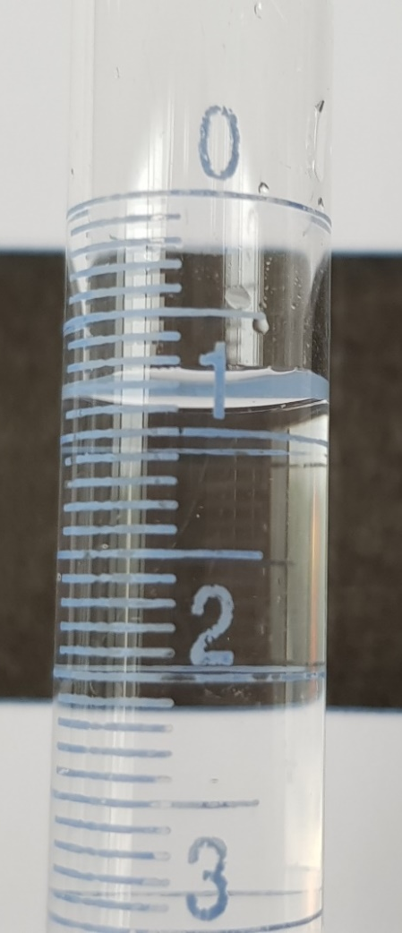
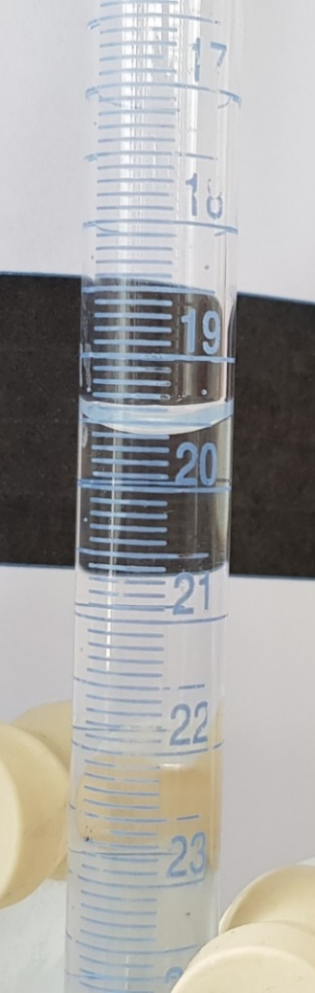
Trial1
Start
Finish

Slide 10
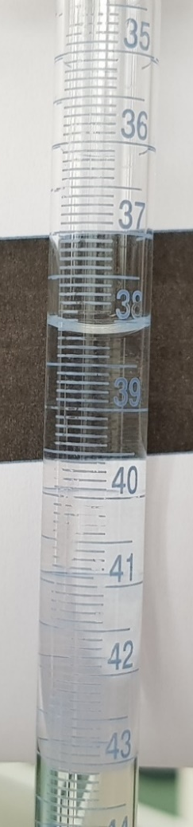
Trial 2
Start
Finish

Slide 11
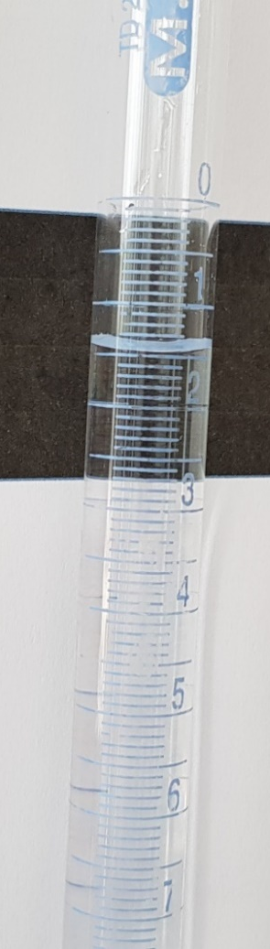
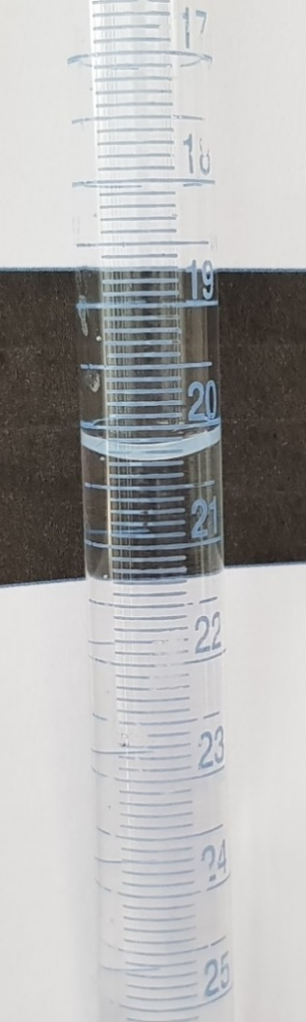
Trial 3
Start
Finish

